Slide 1
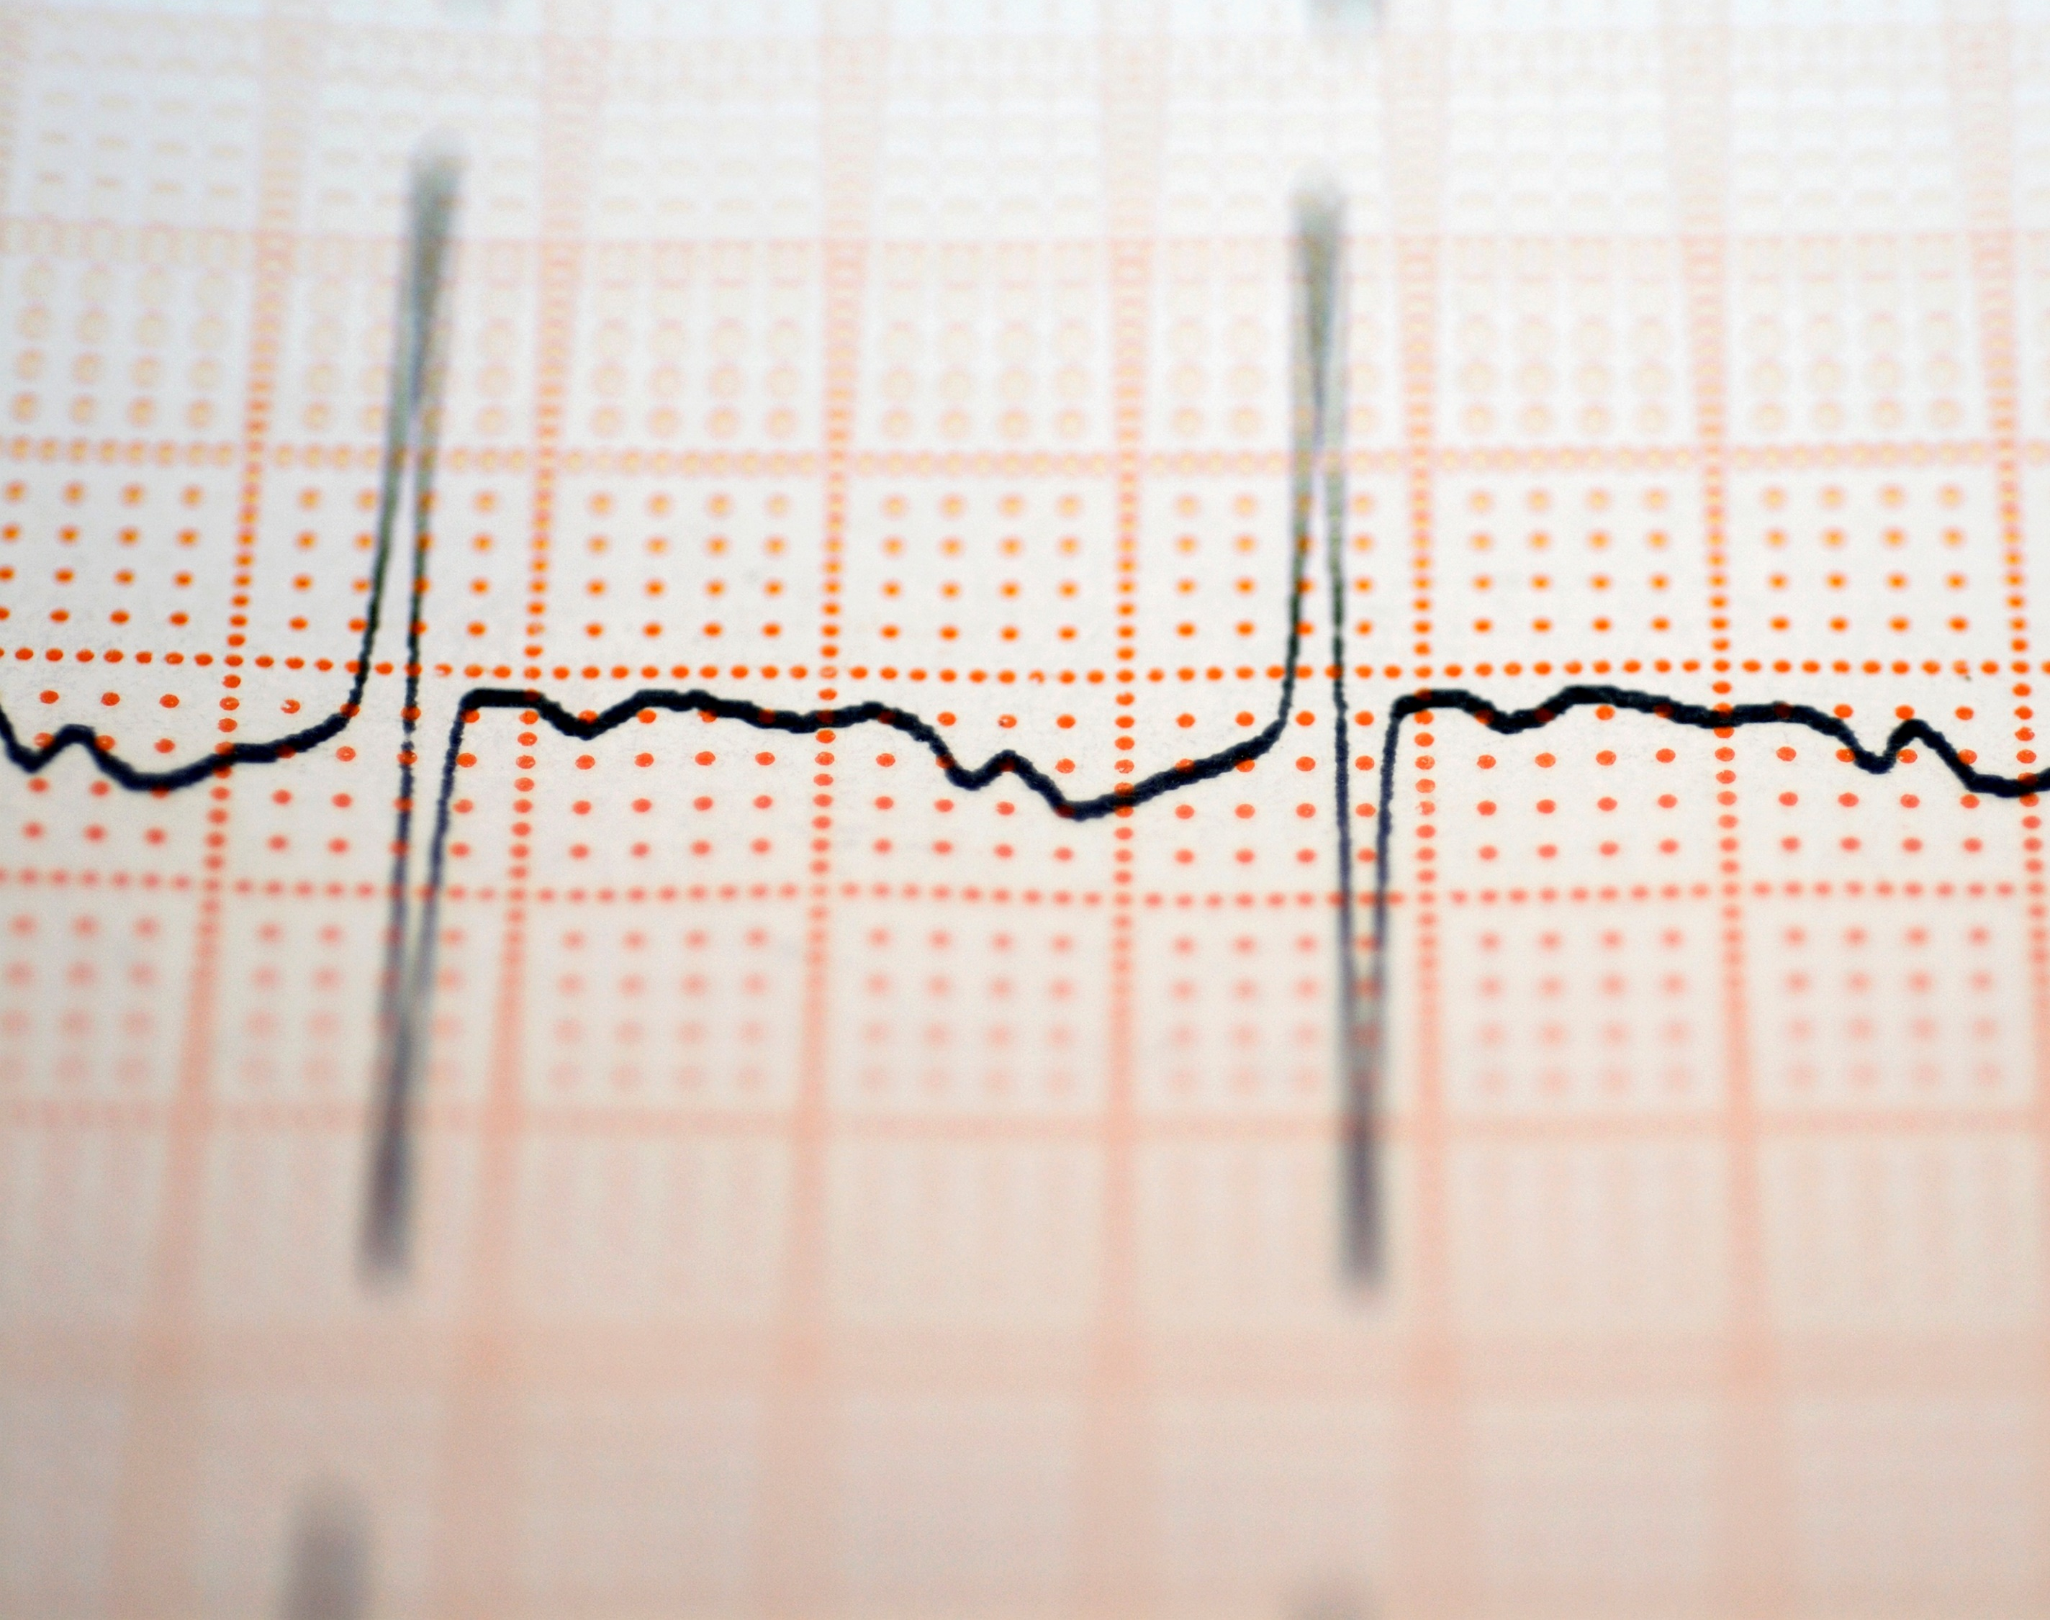
Voting Classifier Model For Predicting Heart Failure
Predicting Heart Failure Dataset
Justin Mattix

Slide 2

Background
Cardiovascular disease kill approximately 17 million people globally a year.
HF occurs when the heart cannot pump enough blood to meet the needs of the rest of the body.
Machine Learning can be used to help medical professionals predict patients' survival and rank what factors contribute the most to HF.

Slide 3
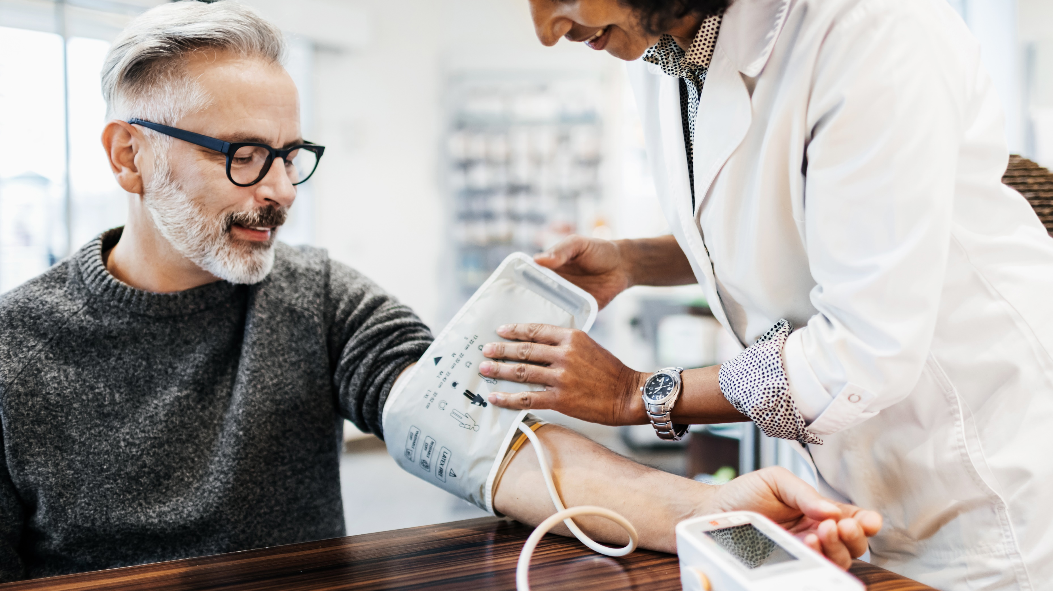
Findings on what correlates to Heart Failure
Highest negative correlation
Time (follow up period in days): -0.527
Highest Positive correlation
Serum Creatinine: 0.294
It’s a waste product in your blood that comes from muscles. A high amount of this could indicate your kidneys aren’t functioning properly

Slide 4
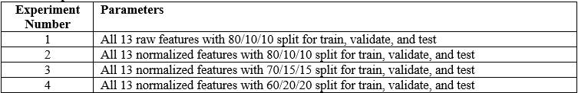
Experimental Parameters

Slide 5

Accuracy for Estimators
Logistic Regression
0.816
Random Forrest
0.83
SVC
0.76
DT (gini)
0.68
DT (entropy)
0.71

Slide 6
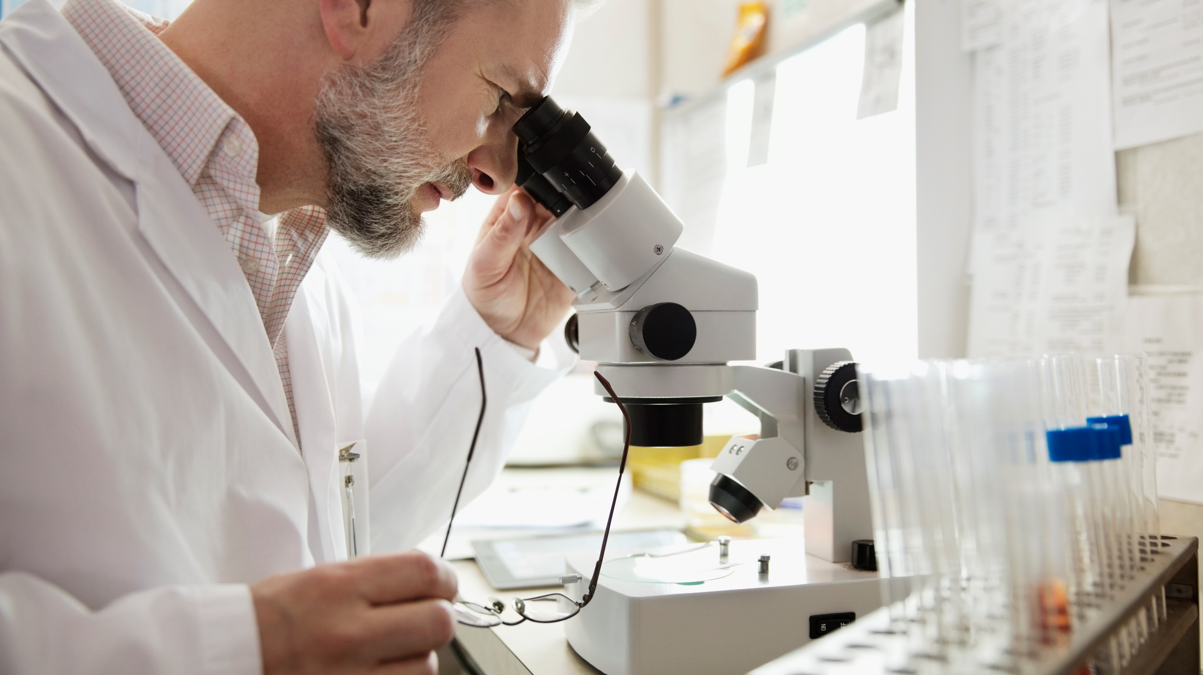
Results on Voting Classifier Accuracy per experiment
Highest Accuracy: Experiment 3
MSE: 0.18
R-Square: 0.13
Lowest Accuracy: Experiment 1
MSE: 0.183
R-Sqaured: 0.164

Slide 7

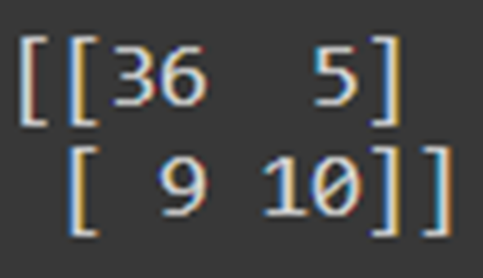
Confusion Matrix
True Positive: 36 – test result that correctly indicates the presence of a condition
False Negative: 5 – test result that indicates the absence of a condition or characteristic
False Positive: 9 – A test result which wrongly indicates that a particular condition is present
True Negative: 10 – A test result which wrongly indicates that a particular condition is absent.

Slide 8

Classification Report
Precision – is the ability of a classifier not to label an instance positive that is negative. For each class it is defined as the ratio of true positives to the sum of true and false positives.
Recall – is the ability of a classifier to find all positive instances. For each class it is defined as the ratio of true positives to the sum of true positives and false negatives.
F1 score – is the weighted harmonic mean of precision and recall such that the best score is 1.0 and the worst is 0.0.

Slide 9
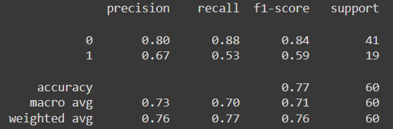
Classification Report cont.

Slide 10
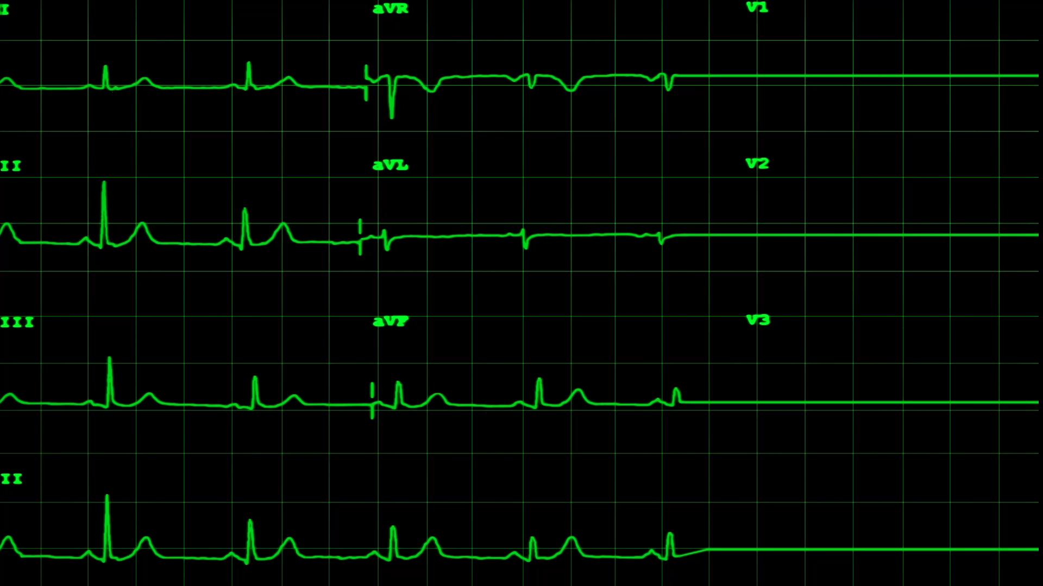
Thank You!

